Slide 1
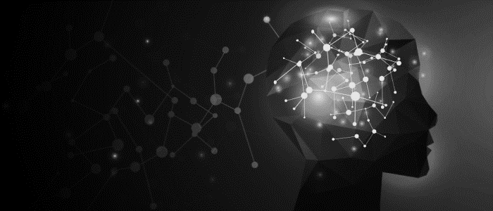
Contrastive Learning
Pattern Analysis and Machine Intelligence
Robin Hammer, Marc Pavlinec, Nathalie Zarbock & Anika Zeilmann

Slide 2
“Contrastive learning is a machine learning technique used to learn the general features of a dataset without labels by teaching the model which data points are similar or different“
(Tiu, 2021)
Notes:
This is a basic explanation of Contrastive Learning, that we found quite intuitive:
“Contrastive learning is a machine learning technique used to learn the general features of a dataset without labels by teaching the model which data points are similar or different“
But how does this work? Let me give you a simple example.
(Next slide)
Link: https://towardsdatascience.com/understanding-contrastive-learning-d5b19fd96607

Slide 3
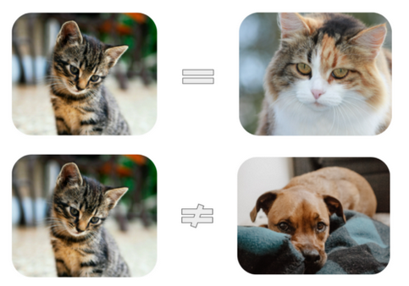
Contrastive Learning
Recognizing the similarities and differences between objects
Leads to learning the high-level features
Tiu, 2021: https://towardsdatascience.com/understanding-contrastive-learning-d5b19fd96607
Notes:
The human brain is the inspiration for the concept of contrastive learning.
Imagine a child that does not know yet the difference between a cat and a dog. But what it does know is, that both look different.
This leads to learning the high-level features of objects.
(Picture on the right)
For example, we could subconsciously recognize that the two cats’ have pointy ears, whereas the dog has droopy ears. Or we may contrast the different shapes of noses both have.
This shows already the major advantage of contrastive loss: It does not need labels!
Let’s go into more detail about this approach (next slide)

Slide 4
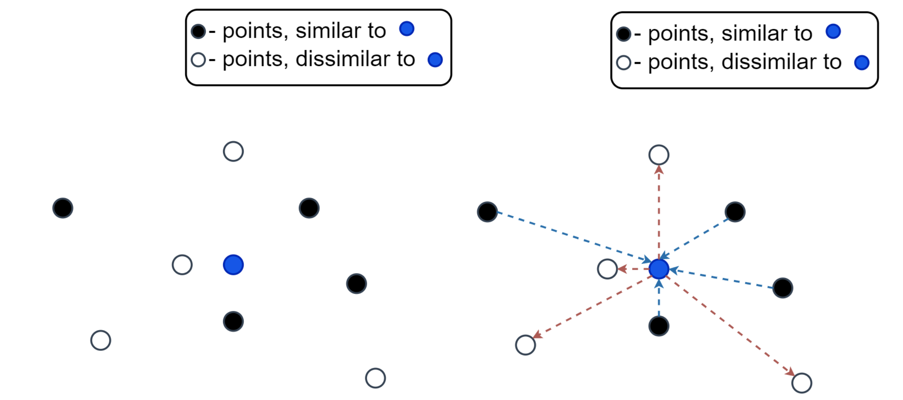
Contrastive Learning
Bekuzarov, 2020: https://medium.com/@maksym.bekuzarov/losses-explained-contrastive-loss-f8f57fe32246
Notes:
Time for a little visualization.
Let’s say we have some data point (blue dot) and a couple of other data points, which are similar to it (black dots) and dissimilar (white dots)
We would naturally like to pull black dots closer to the blue dots and push white dots farther away from it.
Specifically, we would like to minimize the intra-class distances (blue arrows) and maximize the inter-class distances (red arrows).

Slide 5
Contrastive Learning: 3 Challenges
How can we create similar or dissimilar samples?
1
How can we train a network to separate them?
2
How do we evaluate the success?
3

Slide 6
Contrastive Learning: 3 Challenges
How can we create similar or dissimilar samples?
1
How can we train a network to separate them?
2
How do we evaluate the success?
3

Slide 7
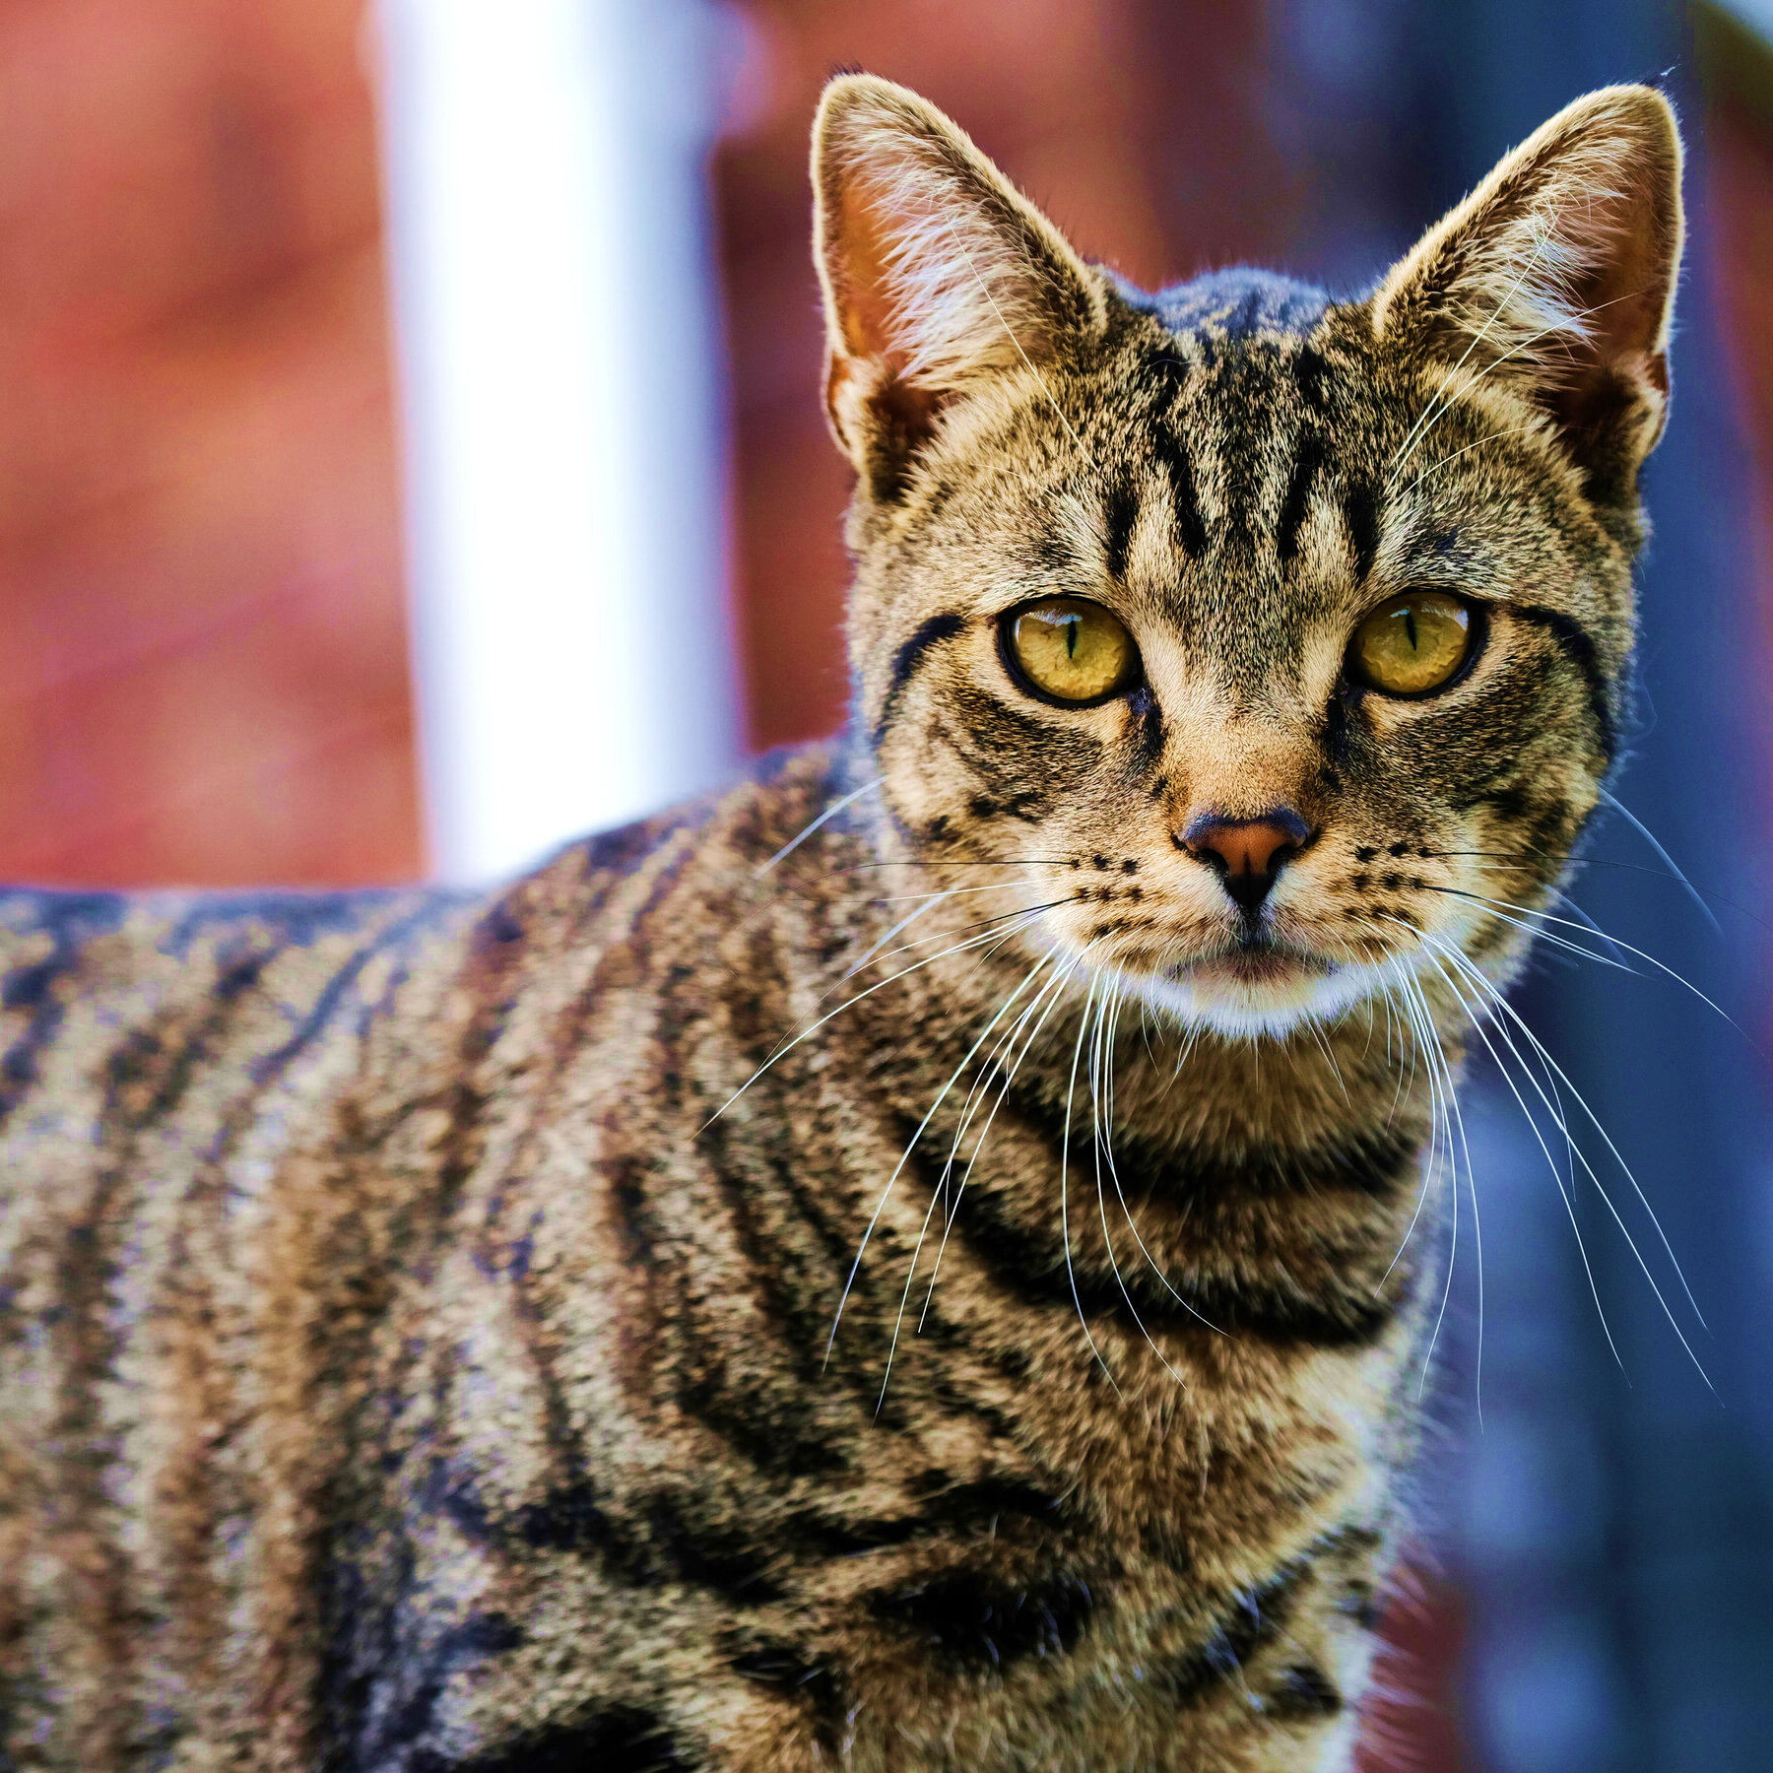
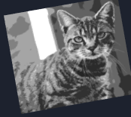
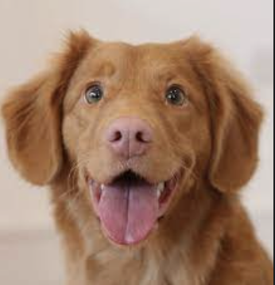
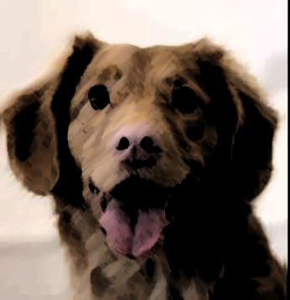
How can we create dissimilar or similar samples?
Augmentation
Positive / Negative Pairs
Triplets
Anchor
positive example
Anchor
positive example
negative example
Anchor
negative example
Anchor
positive example
negative example
Notes:
Magical power of this approach:
-> We can use it for any dataset
-> No matter if image; text or sth else
-> Even without knowing the data labels
Other papers do that too

Slide 8
Contrastive Learning: 3 Challenges
How can we create similar or dissimilar samples?
1
How can we train a network to separate them?
2
How do we evaluate the success?
3

Slide 9
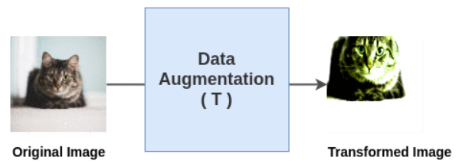
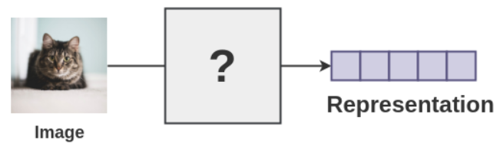
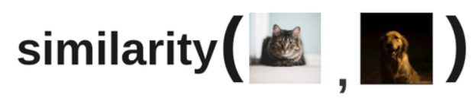
Contrastive Learning
1
Data Augmentation
2
Encoding
3
Loss Minimization of Representations
Tiu, 2021: https://towardsdatascience.com/understanding-contrastive-learning-d5b19fd96607
Notes:
The three basic steps of constrastive learning can be stated as follows.
First, the (1) Image Augmentation for positive and negative pair creation / triplet creation:
As we explained on the previous slide, the model learns from comparing images.
To do so, we need pairs or even triplets of images.
The positive pair creation somewhat replaces category labels.
This works by augmenting the original, also called anchor image.
The augmented picture can then be used as a positive example, meaning an image from the same category/ an image that is similar!
The same goes for triplets, but here we also add a negative example, meaning a picture that is not from the same category.
After the data augmentation and pair/ triplet creation, (2) Encoding takes place.
For the model to learn, the data must be processable.
To achieve that, a tensor representing the image data and information is created
The model is then able to process the input (= feature space)
The last step is to (3) mimize the loss of the representations
This is done to maximize the similarity of vector representations using one contrastive loss function.
For doing contrastive learning, a special network architecture is needed. We will show you now which one it is and why it is needed. (next slide)

Slide 10
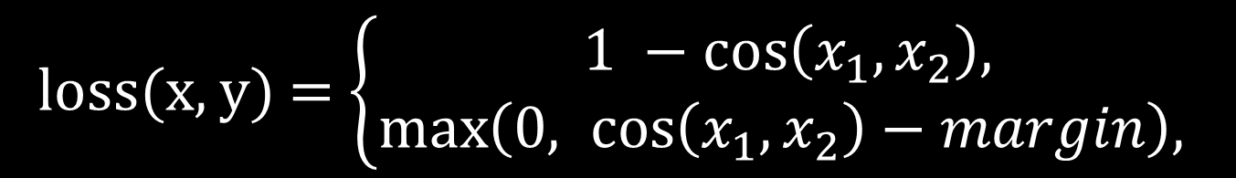
Contrastive Loss: Cosine Embedding Loss
loss(x, y) =$\left\{\begin{aligned}1 −\cos\left(x_{1}, x_{2}\right), \\ \max\left(0, \cos\left(x_{1}, x_{2}\right)−margin\right), \end{aligned}\right.$
if y = 1
if y = -1
Pytorch, n.d.: https://pytorch.org/docs/stable/generated/torch.nn.CosineEmbeddingLoss.html
Notes:
Creates a criterion that measures the loss given input tensors x1​, x2​ and a Tensor label yyy with values 1 or -1. This is used for measuring whether two inputs are similar or dissimilar, using the cosine distance, and is typically used for learning nonlinear embeddings or semi-supervised learning.

Slide 11
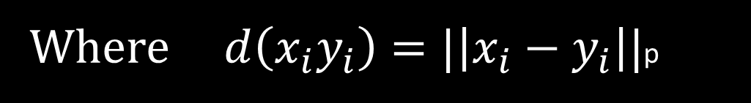
Contrastive Loss: Triplet Margin Loss
$$L\left(a, p, n\right)=max\left\{d\left(a_{i}p_{i}\right)−d\left(a_{i}n_{i}\right)+margin, 0\}\right.$$
Where $d\left(x_{i}y_{i}\right)=|\left|x_{i}{− y}_{i}\right||$p
Pytorch, n.d.: https://pytorch.org/docs/stable/generated/torch.nn.TripletMarginLoss.html
Notes:
Creates a criterion that measures the triplet loss given an input tensors x1, x2, x3 and a margin with a value greater than 000. This is used for measuring a relative similarity between samples. A triplet is composed by a, p and n (i.e., anchor, positive examples and negative examples respectively). The shapes of all input tensors should be (N,D)(N, D)(N,D).
The distance swap is described in detail in the paper Learning shallow convolutional feature descriptors with triplet losses by V. Balntas, E. Riba et al.

Slide 12
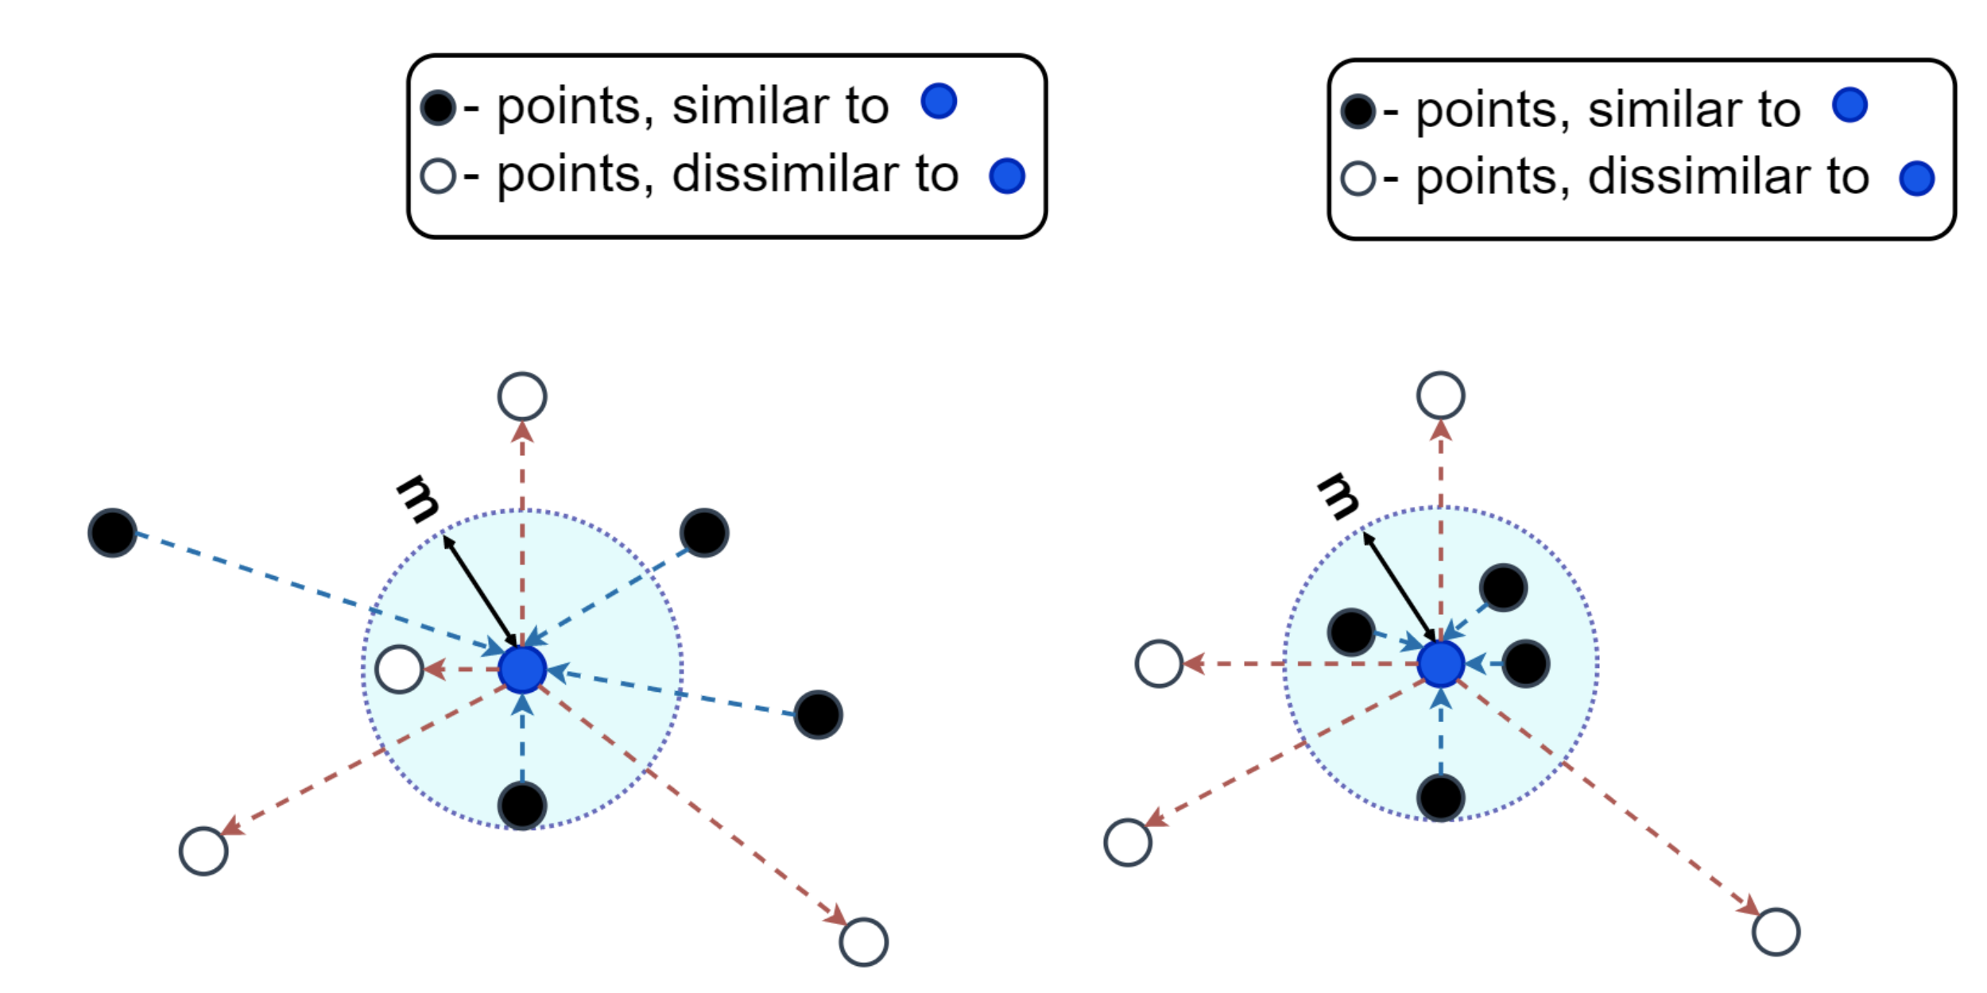
Contrastive Learning: Margin
Bekuzarov, 2020: https://medium.com/@maksym.bekuzarov/losses-explained-contrastive-loss-f8f57fe32246

Slide 13
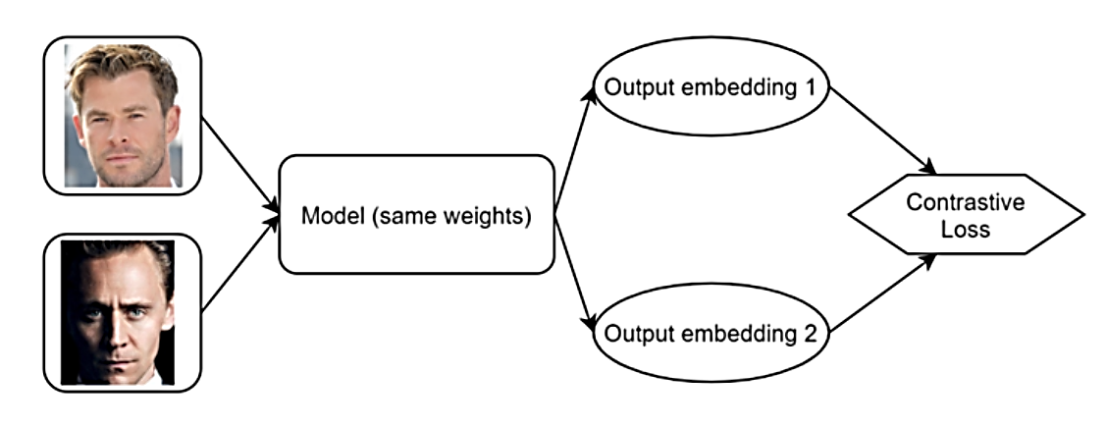
Contrastive learning: Siamese Network Architecture
Bekuzarov, 2020: https://medium.com/@maksym.bekuzarov/losses-explained-contrastive-loss-f8f57fe32246
Notes:
To implement contrastive learning, a Siamese network architecture is needed.
The idea of this architecture is to use two or more identical subnetworks.
They use the same parameters and weights, and the updating is shared across all subnetworks.
This is done to determine the similarity of inputs by feature vector comparison.
Let’s go through this figure to explain the idea again:
You have a convolutional neural network to which 2 images are applied to
Then loss is calculated based on its/the networks’ outputs
The backpropagation algorithm runs

Slide 14
Experimental Setup: Approach
Backpropagation
Representation
Data Augmenta-tion
Encoder
H(i)
Minimize contrastive loss
H(j)
Original image
Transformed Images
Classification
Chaudhary, 2020: https://amitness.com/2020/03/illustrated-simclr/

Slide 15
Experimental Setup: Research Idea
Load the data
1
MNIST
CIFAR10
Use multiple image augmentations
2
Aug 1
Aug 2
Aug 3
Train two CNN:
3
Pairwise
Triplet
4
Visualize via t-SNE
Train classifier on top of model
5
Notes:
So this is what we did, kind of our “to do” list:
First, we needed to find a way to load the data.
Afterwards, we coded different image augmentations.
Usually, one method is enough, but we wanted to research the effects of using different image augmentations
The images samples were then fed into a Siamese network structure. We used one CNN for pairwise comparison, and one for triplet comparison.
This means that 3 images at a time were compared, the original, a positive and a negative example.
After training finished, we used t-SNE to visualize the differences in using different image augmentations and image sample sizes.
Lastly, we coded a classifier on top of the model, to see how the model performed.

Slide 16

The data set: MNIST
10 classes with each class containing 6,000 images
Classes are mutually exclusive
60,000 images for training, 10,000 for testing
Images are sized 28x28px
(LeCun, Cortes, Burges, n.d.: http://yann.lecun.com/exdb/mnist/)
Notes:
CIFAR-10 dataset consists of 10 classes with each 6000 images, so 60,000 samples.
Here, the classes of the dataset and 10 random pictures are shown.
Classes are mutually exclusive, meaning that there is for instance no overlap for automobile and trucks.
From the 60,000 images 50,000 are for training und 10,000 for testing.
The images are sized 28x28 pixels and greyscale

Slide 17
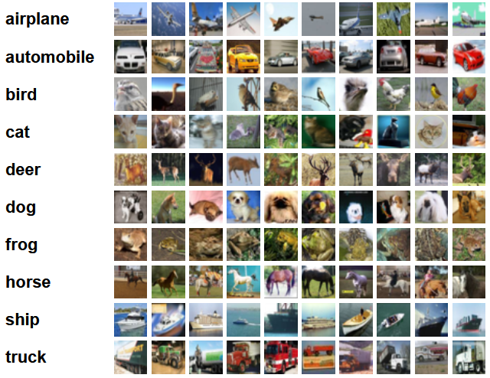
The data set: CIFAR-10
10 classes with each class containing 6,000 images
Classes are mutually exclusive
50,000 for training, 10,000 for testing
Image are sized 32x32px
(Krizhevsky, n.d.: https://www.cs.toronto.edu/~kriz/cifar.html)
Notes:
CIFAR-10 dataset consists of 10 classes with each 6000 images, so 60,000 samples.
Here, the classes of the dataset and 10 random pictures are shown.
Classes are mutually exclusive, meaning that there is for instance no overlap for #example# automobile and trucks.
From the 60,000 images 50,000 are for training und 10,000 for testing.
The images are sized 32x32 pixels and coloured

Slide 18
Contrastive Learning: 3 Challenges
How can we create similar or dissimilar samples?
1
How can we train a network to separate them?
2
How do we evaluate the success?
3
Visualize embedding
Classifier on top of embedding

Slide 19
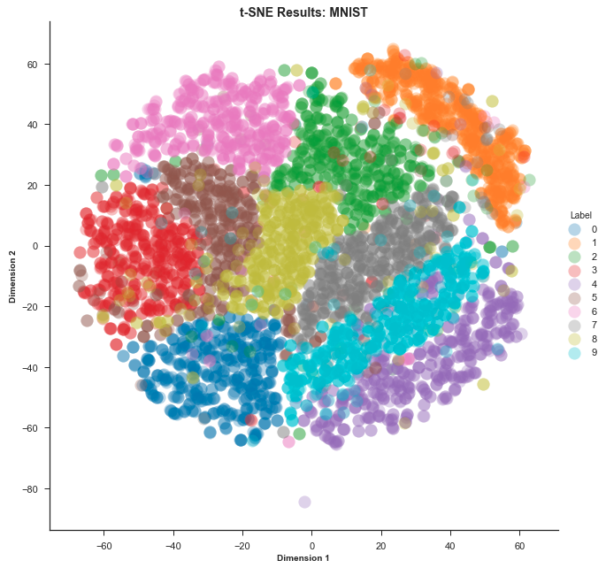
The Comparison: T-SNE
Method to visualize high-dimensional data
Creates intuition on data representation
Calculates similarity measure between pairs of instances in each high and low dimensional space
Tries to optimize similarity measures by using a cost function
Violante, 2018: https://towardsdatascience.com/an-introduction-to-t-sne-with-python-example-5a3a293108d1
Notes:
SNE is a tool to visualize high-dimensional data
It gives a feel or intuition on how data is arranged in a high-dimensional space.
The algorithm calculates a similarity measure between pairs of instances in the high dimensional space and in the low dimensional space
Then it tries to optimize these two similarity measures by using a cost function.

Slide 20
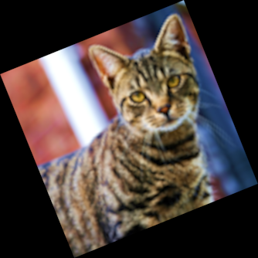
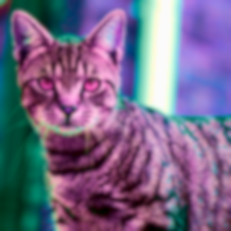
The Comparison: Different Augmentations
1
None
2
Rotation
3
SimCLR
Use as baseline for comparing augmentations
Normalize, conversion to tensor
Used in “Deep Neural Networks with Relativity Learning for Facial Expression Recognition”
Pad, Rotate and Scale
Used in network “SimCLR”
Augmentation is stochastic
Random: Crop + Resize, Color Distortion and Gaussian Blur
Notes:
(1) Plain Augmentation
Goal of keeping augmented images close to original, only normalization is added,
which changes the range of pixel-intensity so that the image is closer to what humans perceive in reality
-> We also tried very simple augmentations; e.g. only flip horizontally; similar behavior as plain
(2) Augmentation used in SimClR (Simple Framework for Contrastive Learning of Visual Representations)
Random Application of 3 different augmentations:
- Random Crop and resize back to origin size
Random Color Distortion
Random Gaussian Blur
(3) Augmentation used in Deep Neural Networks with Relativity Learning for Facial Expression Recognition
- Resize,
Random scaling +/- 10,
Padding 0 (stands for black colour fill) to size of 120
Random Rotate between +/- 15°
Random Crop to size 108x108

Slide 21
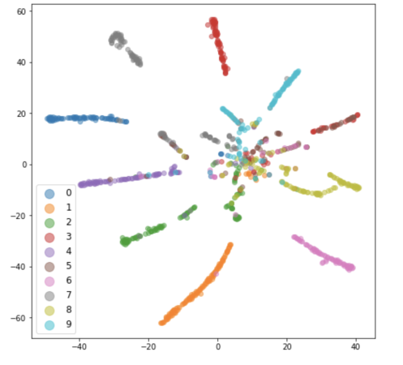
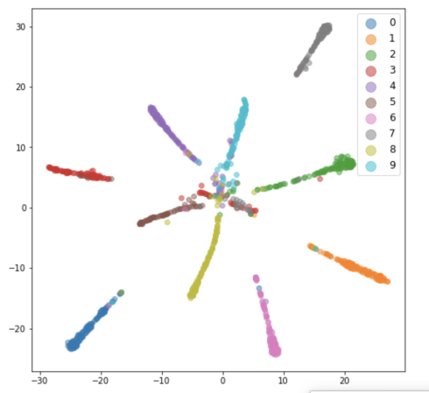
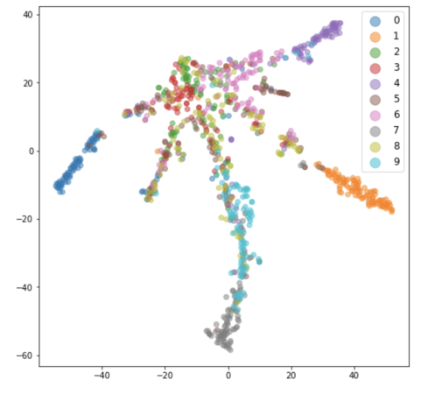
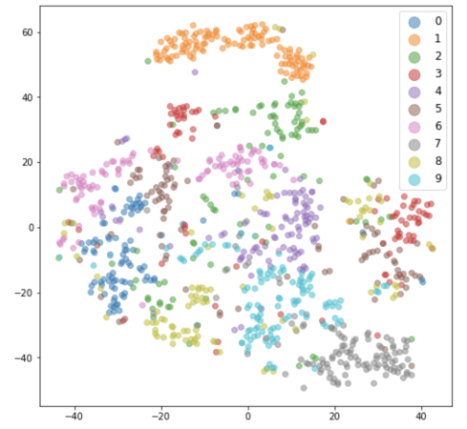
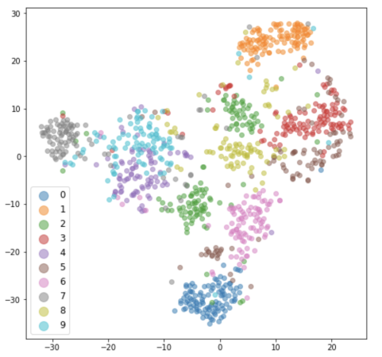
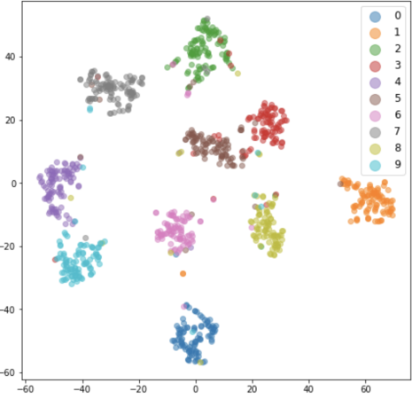
The Comparison: Different Augmentations
MNIST
1
None
2
Rotation
3
SimCLR
Pairwise
Triplet
Notes:
This is the MNIST data set.
Columns: Different augments
In the rows, you can see the difference between pairwise and triplet training.
For every combination, the results in form of t-SNE are shown.
Best: Pairwise, SimCLR

Slide 22
The Comparison: Different Augmentations
MNIST
1
None
2
Rotation
3
SimCLR
Pairwise
Pairwise
A
B
C
Triplet
Triplet
A
B
C
Notes:
This is the MNIST data set.
Columns: Different augments
In the rows, you can see the difference between pairwise and triplet training.
For every combination, the results in form of t-SNE are shown.
Best: Pairwise, SimCLR

Slide 23
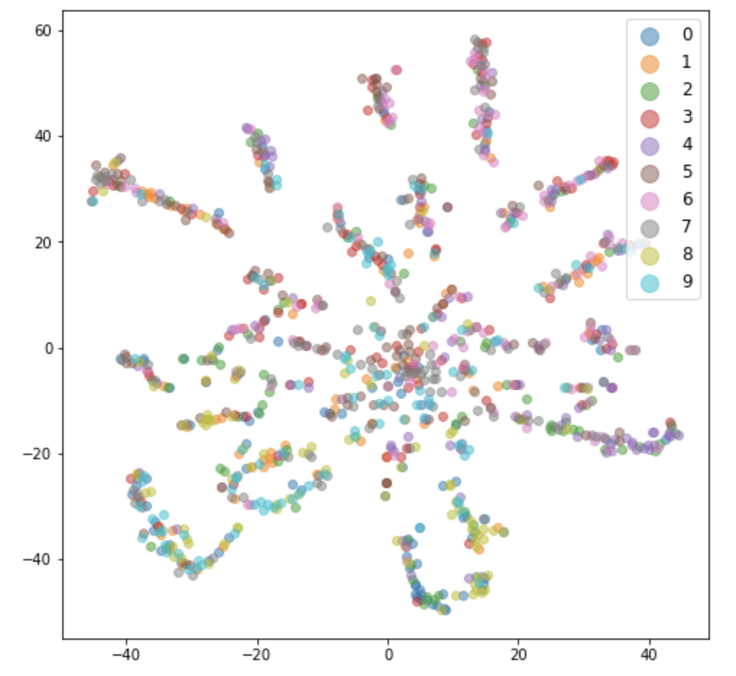
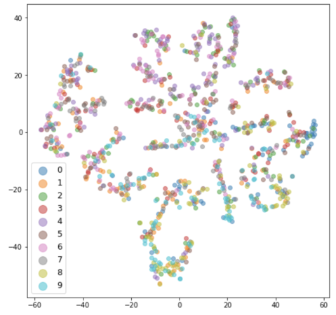
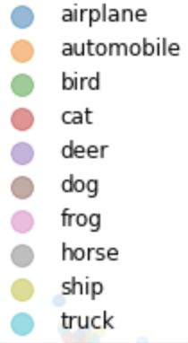
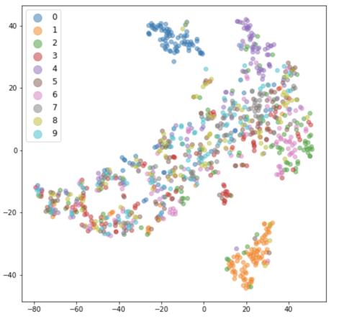
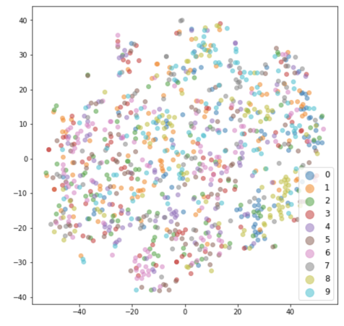
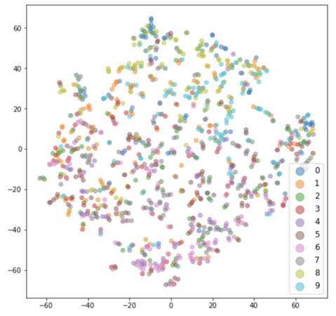
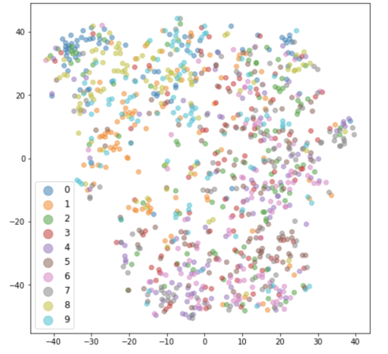
The Comparison: Different Augmentations
CIFAR-10
1
None
2
Rotation
3
SimCLR
Pairwise
Triplet

Slide 24
The Comparison: Different Augmentations
CIFAR-10
1
None
2
Rotation
3
SimCLR
Pairwise
Pairwise
A
B
C
Triplet
A
B
C
Triplet
Notes:
This is the MNIST data set.
Columns: Different augments
In the rows, you can see the difference between pairwise and triplet training.
For every combination, the results in form of t-SNE are shown.
Best: Pairwise, SimCLR

Slide 25
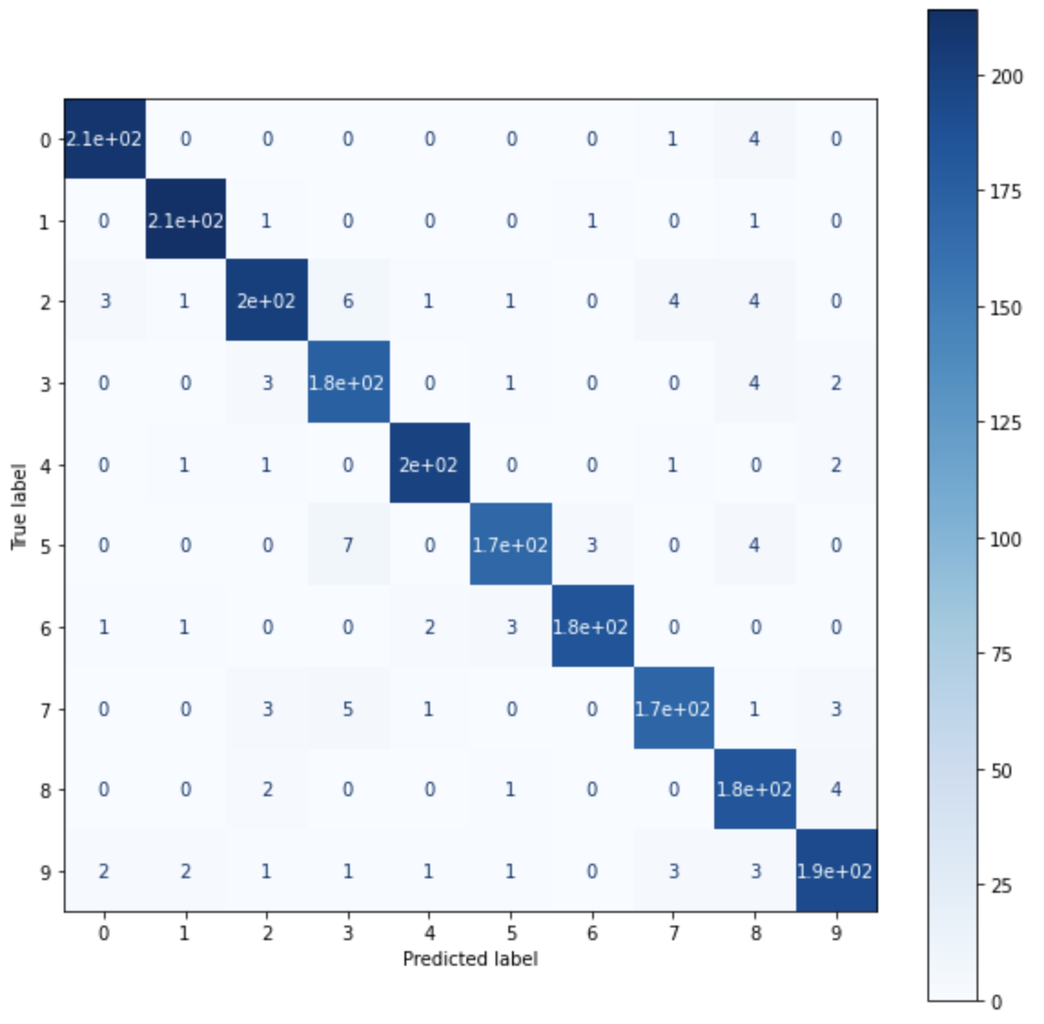
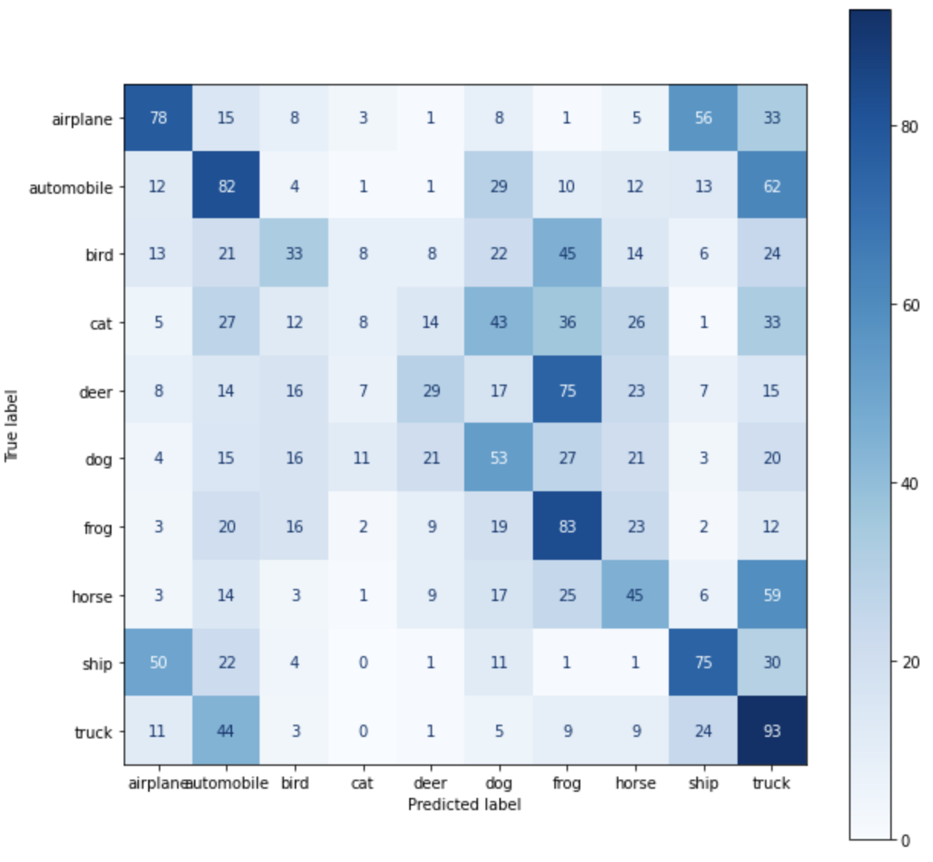
Results: Classifier
SimCLR - Triplet
MNIST
CIFAR-10

Slide 26
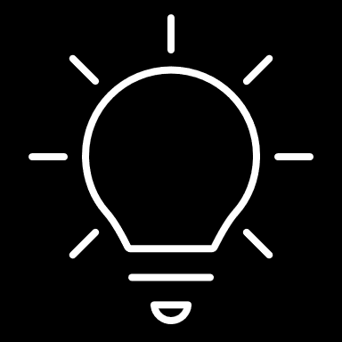
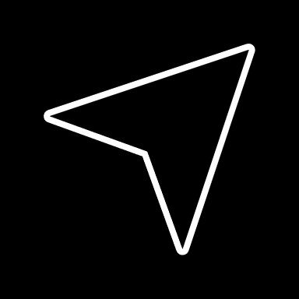
Observations & Outlook
The augment does impact results, but not necessarily as expected (more is not always better!)
Comparing the data sets, the complexity of pictures seems to influence results
Triplet training led to clustering, whereas pairwise led to line-like structures
Outlook
Triplet Mining
Different loss functions
Supervised contrastive learning

Slide 27
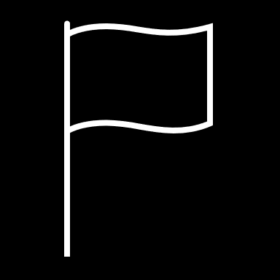
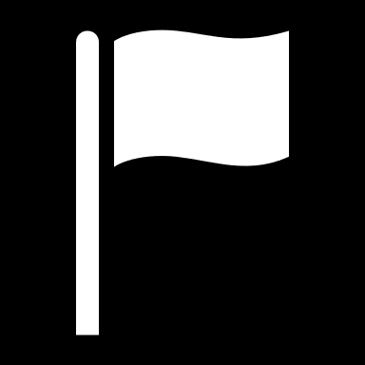
Lessons Learned
Creation of pairs and triplets
Start
Choosing the data set
Tuning of CNN
End
Notes:
First we took a brute force approach and tried to do everything at once.
Back then we considered using the FER Dataset or FEC dataset, but settled with the FER dataset and tried to generate our own triplets and positive/negative pairs.
However, processing took a lot time and wasn‘t efficient enough for us to work with, so we wanted to use a integrated dataset that is contained in the pytorch dataset collection.
We decided to use CIFAR-10 as it seemed to us complex enough and it was easy to use.
Shortly after we built a CNN for pairwise and triplet training and visualized our training results with T-SNE
Our CNN wasn‘t really good at first, so we wanted to compare it with a common dataset, so we took MNIST, because we figured it would deliver better results due to the categories of pictures.
Following that we tweaked our CNN further and built a classifier from our trained model.

